Slide 1
Azure Defender for IoT
400.3 Enterprise Data Integration

Slide 2
Agenda
Overview
Create a Custom Column
Populate manually
Populate dynamically
Notes:
Point out website

Slide 3
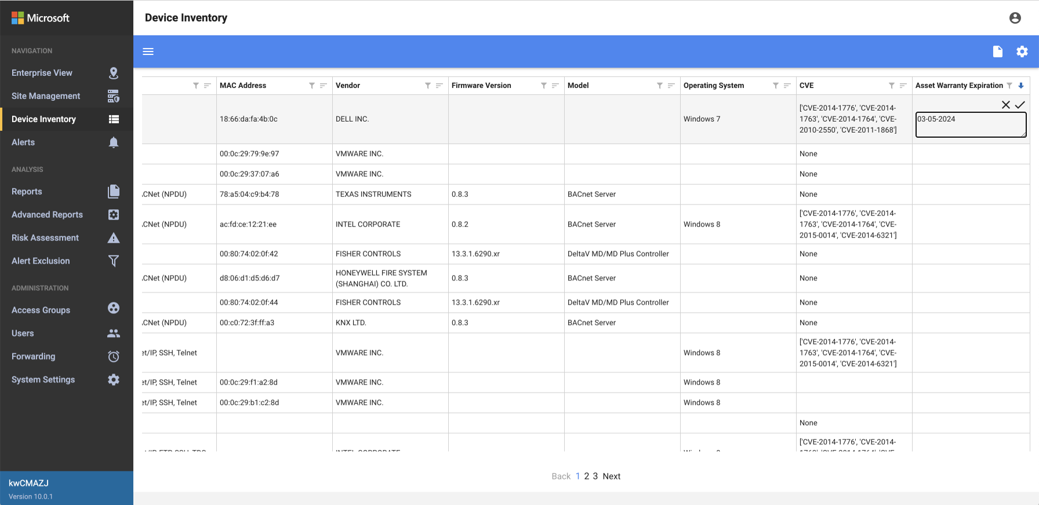
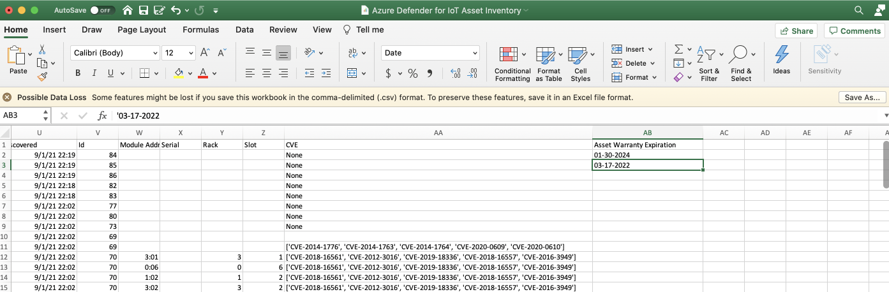
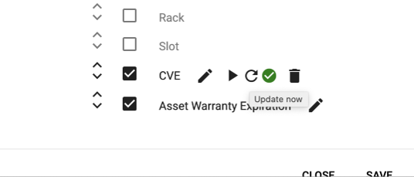
Enterprise Data Integration – Overview
3 ways to populate custom columns once created
Manually
Using Central Manager
Manually
Using an external tool such as Excel
Dynamically
Using a script

Slide 4
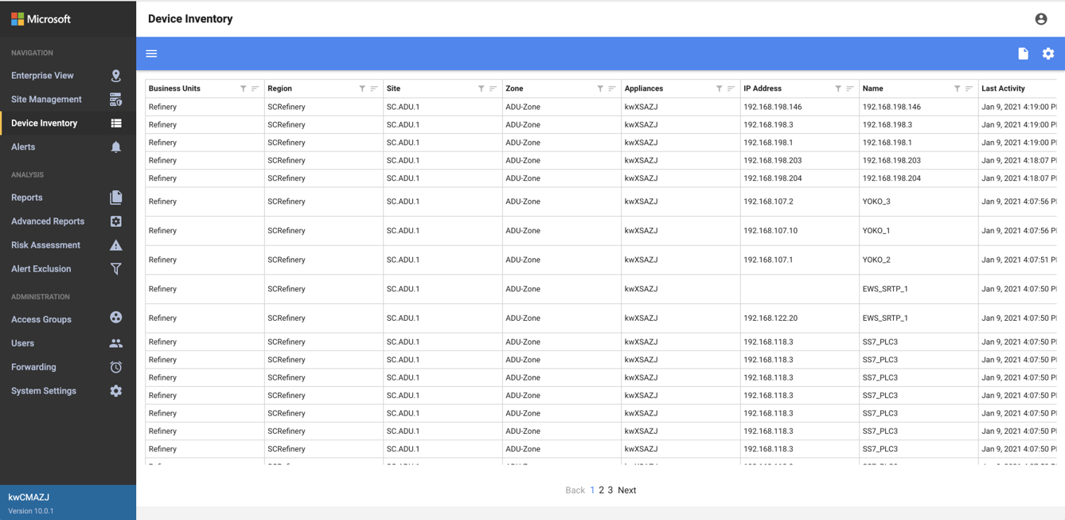
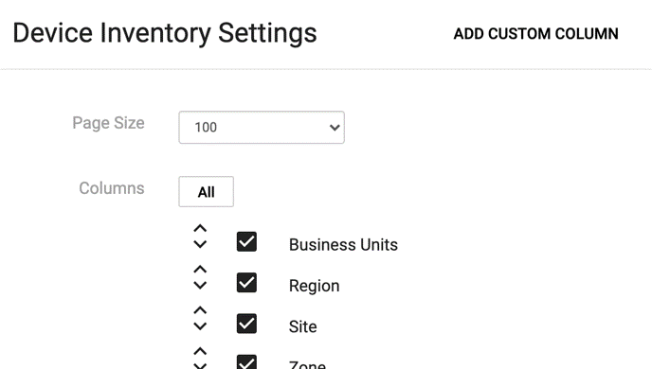
Enterprise Data Integration
Create a custom column – manually populate within the Central Manager
Go to Device Inventory
Click the gear icon to add a custom column

Slide 5
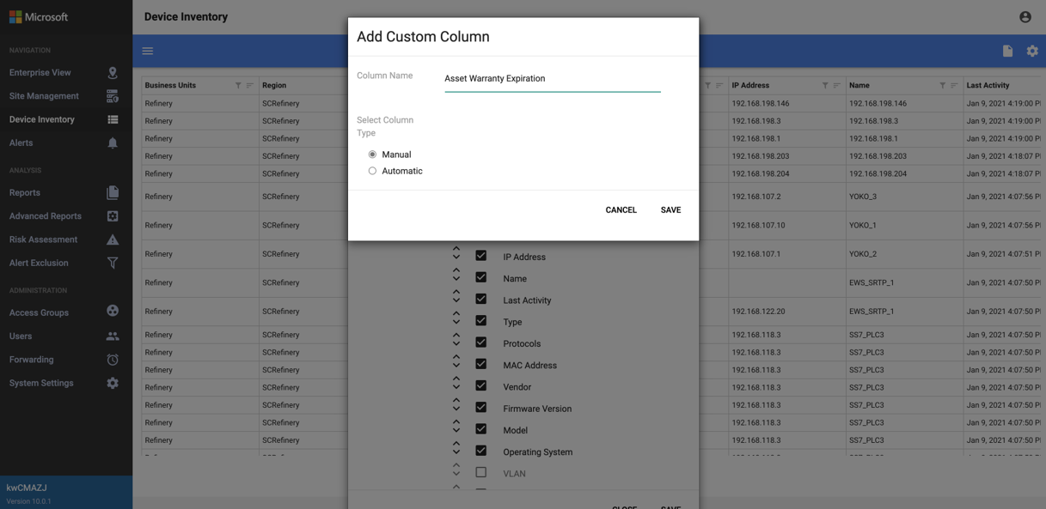
Enterprise Data Integration
Create a custom column – manually populate within the Central Manager
Enter the name of the column for the data you wish to track
Leave Column Type as ‘Manual’
Click Save (twice)

Slide 6
Enterprise Data Integration
Create a custom column – manually populate within the Central Manager
Hover in the cell and click the pencil icon to edit a cell, enter the data, then select the checkmark icon to save it (or press return)

Slide 7
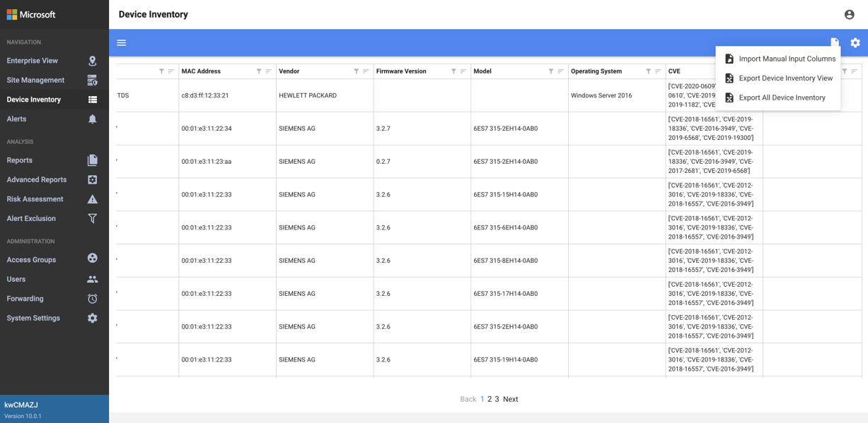
Enterprise Data Integration
Create a custom column – manually populate externally
Select the report icon next to the gear icon and choose ‘export all device inventory’ and save as a .csv

Slide 8
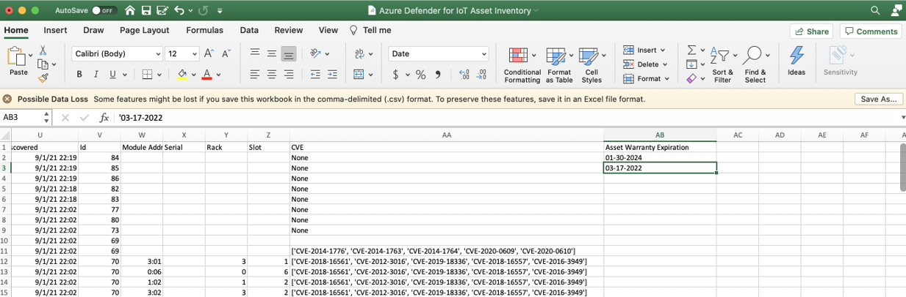
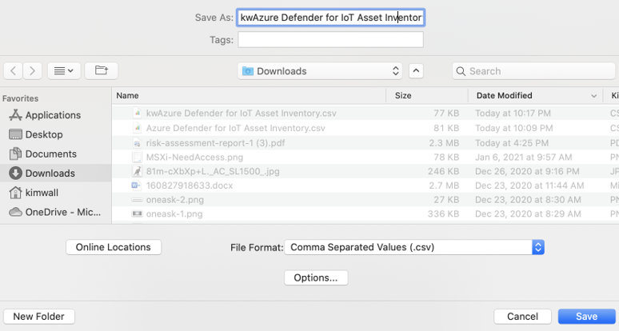
Enterprise Data Integration
Create a custom column – manually populate externally
Open the .csv in Excel and add information to the custom column
When finished, save the file as a .csv

Slide 9

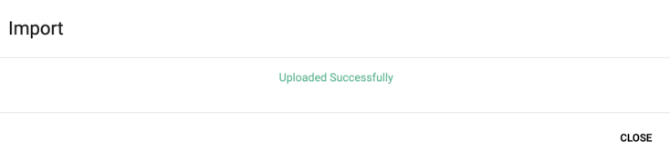
Enterprise Data Integration
Create a custom column – manually populate externally
In the Central Manager > Device Inventory, select the report icon and ‘import manual input columns’
Choose .csv the file just saved
A window will appear showing the success of the import

Slide 10
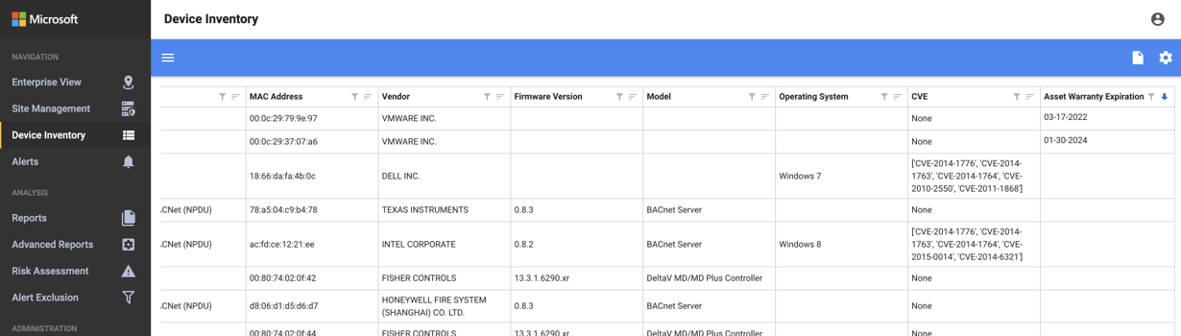
Enterprise Data Integration
Create a custom column – manually populate externally
The custom column will now have the new data entered within the Excel .csv file

Slide 11
Enterprise Data Integration
Create a custom column – dynamically populate
Go to Device Inventory
Click the gear icon to add a custom column

Slide 12
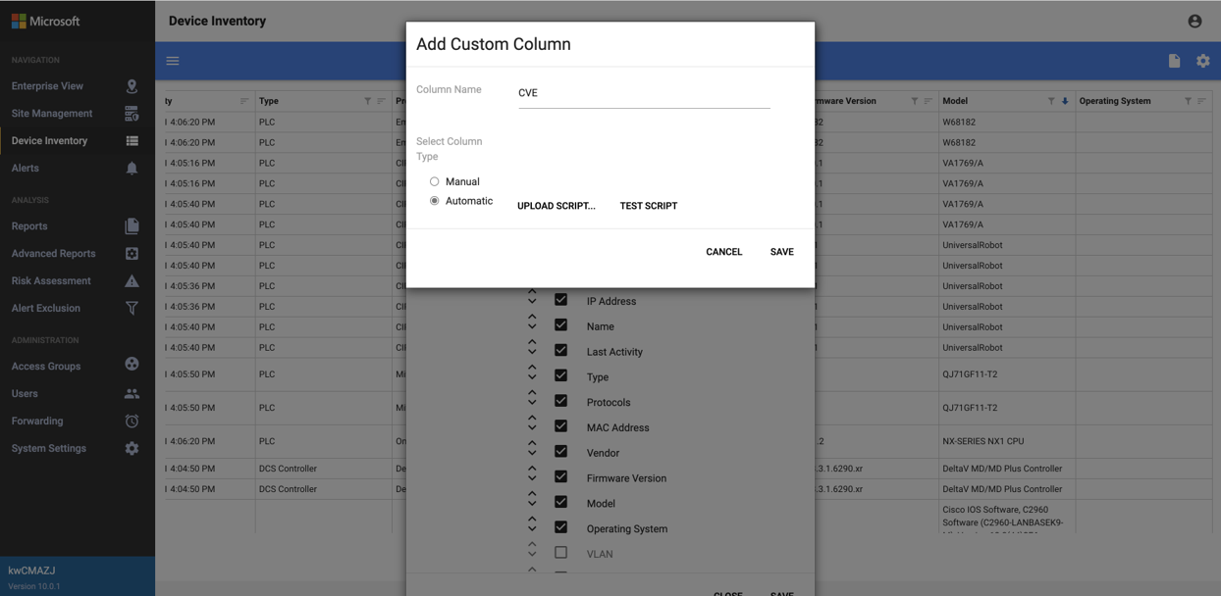
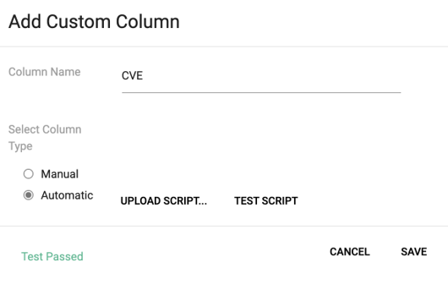
Enterprise Data Integration
Create a custom column – dynamically populate
Enter the name of the column for the data you wish to track
Choose Column Type as ‘Automatic’
Select ‘Upload script’ and choose the local python script to dynamically populate the custom column
Once script is successfully uploaded, select ‘test script’ to validate the script structure
Save

Slide 13

Enterprise Data Integration
Create a custom column – dynamically populate
You will be returned to the columns window
Hover over the pencil icon for the column just created and select ‘update now’ and then Save

Slide 14
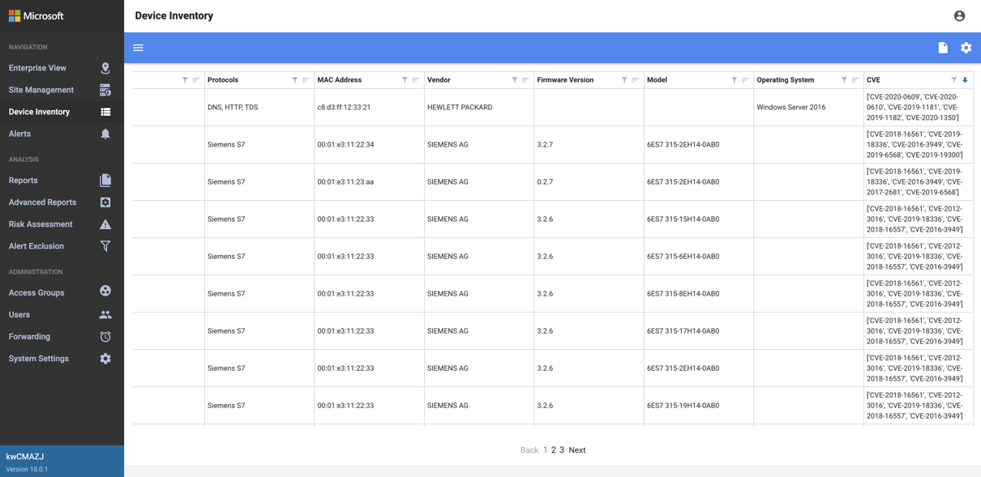
Enterprise Data Integration
Create a custom column – dynamically populate
After script is run, the custom column should be populated with the information
The script will run every 60 minutes by default to refresh the data

Slide 15
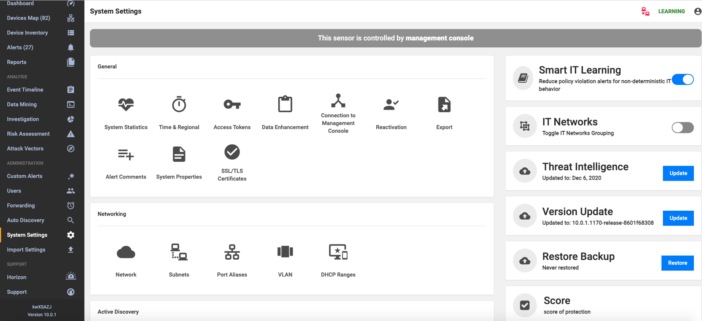
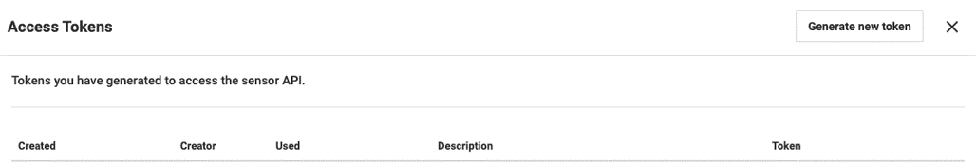
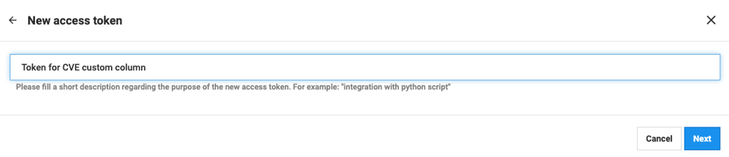
Enterprise Data Integration
Create a custom column – dynamically populate
API Token Generation
When using a script to add data to a custom column, you can generate an API Token to keep it secure and simple
System Settings > Access Tokens > Generate new token

Slide 16
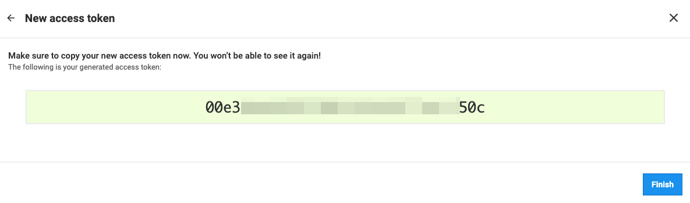
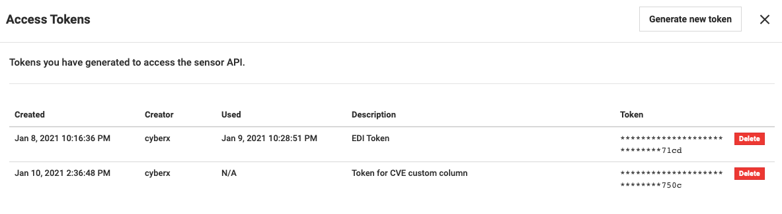
Enterprise Data Integration
Create a custom column – dynamically populate
When generation is finished, select ‘Finish’
You will see a list of generated tokens with their descriptions
Note that the token is only displayed once and never again – store it in a safe place

Slide 17
Enterprise Data Integration – Summary
3 ways to populate custom columns once created
Manually
Using Central Manager
Manually
Using an external tool such as Excel
Dynamically
Using a script

Slide 18
Thank you

